Slide 1
The DD➔OO Recipe
CS 5010 Program Design Paradigms
"Bootcamp"
Lesson 10.4
© Mitchell Wand, 2012-2014
This work is licensed under a Creative Commons Attribution-NonCommercial 4.0 International License.

Slide 2
Introduction
We’ve seen the connections:
objects are like structs
classes are like define-structs
interfaces are like data definitions
We’ve seen that an OO program is just like a functional program, but with the pieces arranged in a different way
If I had a functional program, just what would I need to do to convert it to an OO program?

Slide 3
Goals of this lesson
Learn how to translate from data definitions to classes and interfaces
Learn how to go from function definitions to method definitions (in more detail)
If the last lesson was the Big Picture, then this is the Small Picture.

Slide 4
Objects and Classes as Data Designs
Objects and Classes provide a new representation for information.
This representation is different from the one we have been using, but the correspondence between the two representations is simple.
Here it is:

Slide 5
Representing information using classes and interfaces
Functional Organization | Object-Oriented Organization
Compound Data | Class with the same fields
Itemization Data | Interface
Mixed Data | Interface specifies functions that work on that information One class for each variant, with the same fields as the variant Each class implements the interface

Slide 6
Shapes: Data Definition
(define-struct my-circle (x y r color) #:transparent)
(define-struct my-square (x y l color) #:transparent)
(define-struct my-composite (front back) #:transparent)
;; A Shape is one of
;; -- (make-my-circle Number Number Number ColorString)
;; -- (make-my-square Number Number Number ColorString)
;; -- (make-my-composite Shape Shape)
;; interp:
;; ...
Here is the data definition for our shapes example.

Slide 7
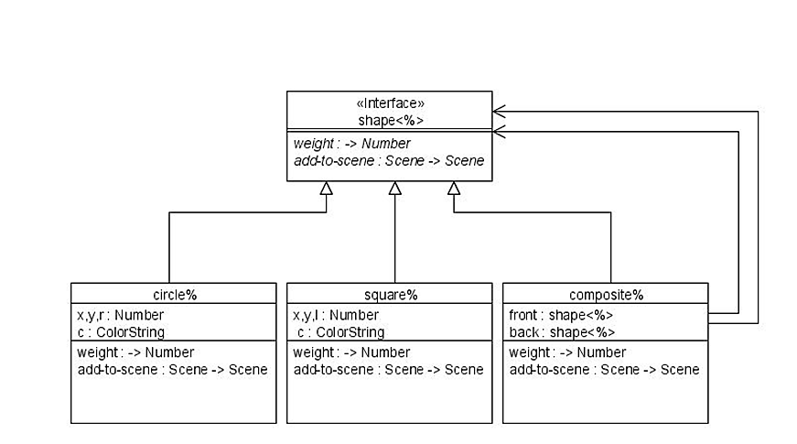
Shapes: Class Diagram
And here is the corresponding class diagram. We have an interface for shapes, and three classes corresponding to the three variants. Each class has fields corresponding to the fields of the variant.
Note that we don't know the class of front or back. We only know their interface, but that's enough!

Slide 8
Recipe for converting from data defs to interfaces and classes
Converting from Data Definitions to Interfaces and Classes
1. Define an interface for each kind of enumeration data.
2. Define a class for each kind of compound data. In the class, put in an init-field for each field in the struct.
3. Convert (make-whatever ...) to (new whatever% [field1 ...][field2 ...])
4. For each function that follows the template, add a method to the interface.
5 . Convert functions to methods. (see recipe below)
Here is a recipe for converting from data definitions and functions to interfaces and classes. The details of this recipe are specific to Racket, but the ideas can be used in any object-oriented language.

Slide 9
Example
(define Baz<%>
(interface ()
...
))
(define Foo%
(class* object% (Baz<%>)
(init-field
field1 left right)
...
(super-new)))
(define Bar%
(class* object% (Baz<%>)
(init-field lo hi)
...
(super-new)))
(define-struct foo
(field1 left right))
(define-struct bar (lo hi))
;; Data Definition
;; A Baz is one of
;; -- (make-foo
Number Baz Baz)
;; -- (make-bar
Number Number)
Here’s an example of steps 1 and 2 of the recipe. The compound data Baz, with variants foo and bar, turns into an interface Baz<%> , with classes Foo% and Bar% that Implement Baz<%> .

Slide 10
Creating Objects
Replace
(make-bar 12 13)
by
(new Bar% [lo 12][hi 13])
Here’s an example of step 3 of the recipe.

Slide 11
From function calls to method calls
Instead of saying
(baz-fn a-baz n)
say
(send a-baz fn n)
Think:
"Send John a book"
(not "send a book to John").

Slide 12
From Function Definitions to Method Definitions
Converting a Function Definition to a Method Definition
1. Add function name to interface
2. Pull out the parts
3. Change selectors to field references
4. Change function calls to method calls
5. Put method definitions into classes
Here is a recipe for converting a function definition to a method definition. This expands step 5 of the recipe above.

Slide 13
Turning a function definition into a set of method definitions
Example:
;; baz-mymin : Baz Number -> Number
(define (baz-mymin b n)
(cond
[(foo? b) (min
(foo-field1 b)
(baz-mymin (foo-left b) n)
(baz-mymin (foo-right b) n)
(other-fn b n))]
[(bar? b) (min
n (bar-lo b) (bar-hi b))]))

Slide 14
1. Add function name to the interface
First we add a method for this function to the interface. The name of the method need not be the same as the name of the function, but it should be similar.
Add to baz interface:
(define baz<%>
(interface ()
mymin ; Number -> Number
other-fn ; Number -> Number
...
))
The function version had contract
Baz Number -> Number ,
so the method has contract
Number -> Number , since the Baz argument is replaced by "this" object.
Here's another function that we have put in the interface.

Slide 15
Original Function Definition
Example:
;; baz-mymin : Baz Number -> Number
(define (baz-mymin b n)
(cond
[(foo? b) (min
(foo-field1 b)
(baz-mymin (foo-left b) n)
(baz-mymin (foo-right b) n)
(other-fn b n))]
[(bar? b) (min
n (bar-lo b) (bar-hi b))]))

Slide 16
2. Pull Out the Parts
Example:
;; baz-mymin : Baz Number -> Number
(define (baz-mymin b n)
(cond
For a foo: (min
(foo-field1 b)
(baz-mymin (foo-left b) n)
(baz-mymin (foo-right b) n)
(other-fn b n))
For a bar: (min
n (bar-lo b) (bar-hi b))

Slide 17
3. Change Selectors to field references
Example:
;; baz-mymin : Baz Number -> Number
(define (baz-mymin b n)
(cond
For a foo: (min
field1
(baz-mymin left n)
(baz-mymin right n)
(other-fn this n))
For a bar: (min
n lo hi)
(foo-left b) is replaced by the field left.
A b that appears by itself refers to the whole struct, so it is replaced by this.

Slide 18
4. Change Function Calls to Method Calls
Example:
;; baz-mymin : Baz Number -> Number
(define (baz-mymin b n)
(cond
For a foo: (min
field1
(send left mymin n)
(send right mymin n)
(send this other-fn n))
For a bar: (min
n lo hi)

Slide 19
5. Put method definitions into classes
Example:
;; baz-mymin : Baz Number -> Number
(define (b n)
In Foo%: (define/public (mymin n)
(min
field1
(send left mymin n)
(send right mymin n)
(send this other-fn n))
In Bar%: (define/public (mymin n)
(min
n lo hi)

Slide 20
Summary
We've seen the connections:
objects are like structs
classes are like define-structs
interfaces are like data definitions
We've seen how to translate from data definitions to classes and interfaces
We've seen how to go from function definitions to method definitions.

Slide 21
Summary
You should now be able to convert any set of functions working on mixed data to an OO style.

Slide 22
Next Steps
Study example 10-7 in the Examples folder.
Do the Guided Practices
If you have questions about this lesson, ask them on the Discussion Board
Go on to the next lesson

